Slide 1
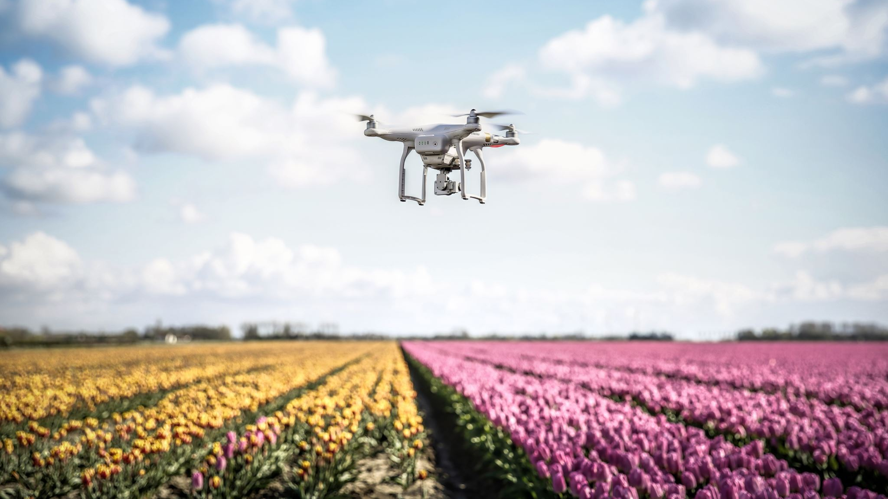
Drone Application -- Group H
November 30, 2021

Slide 2
Agenda
Introduction
Drone simulation in AirSim (Dustin)
Drone simulation in Unity (Peyton)
Drone simulation in ROS-Gazebo (Krishna)
Sentinel-2 : Satellite for Crop Specific Monitoring (Durga Sai Kiran)
Vegetative Indices (Wanya)

Slide 3
Shelby's Slide
Drone application for agricultural use is an efficient method to communicate information between drones and farmers.
Many agricultural jobs are being switched to drones because of the bot's ability to complete the assignments in a safe and concise manner as well as their low cost.
Drone applications in agriculture are allowing users to keep an eye on their crops using a vegetative index and a bird's-eye view, spray their fields with fertilizer and/or pesticides, planting seeds, surveying and mapping potential farmland, and monitoring irrigation.

Slide 4
Shelby's Slide
Drones also are being used to monitor weather using Arduino Sensors. The sensors help farmers monitor rainfall, sunlight (which include for how long and the intensity of the light), and the temperature.
A drone that is currently in production, according to my citations, also will sense radiation and humidity. The paper outlines an experiment done by the authors where they take the reader through a step-by-step process of building the drone.

Slide 5
Shelby's Slide
Drones are also helpful in weed management. Since drones are able to cover more ground in a short amount of time, they are used for monitor weeds by taking photos and identifying them through different processes, like deep and convolution neural networks and object-based image analysis.
RBG, multispectral and hyperspectral camera are the most common for weeds since they provide accuracy.
However, the accuracy of all devices mostly depends on the drone's altitude, the camera used (mainly the resolution), and the drones themselves.
Many weeds are a threat to other plants, so it is important to find and identify them in a timely and precise manner that drones provide.

Slide 6
Shelby's Slide
Once the weeds are found and identified, measures of removal can be taken with drones as well.
Since many pesticides and herbicides are linked to problematic health conditions, like cancer, even with precautionary measures taken, such as suits, gloves, and masks, many people still become ill or lose their life due to the harmful chemicals.
Asthma, reproductive issues, hypersensitivity, and allergies are also concerning side effects from working at such close proximity to the harmful chemicals.
Therefore, drones are a good solution since using pesticides and herbicides have become necessary and sometimes, unavoidable.

Slide 7
Shelby's Slide
Drones are also beneficial in other aspects of agriculture, such as livestock.
Sheep farms are heading sheep using drones since there are some concerns using sheep dogs.
The concerns range from the safety of both animals, the dog getting kicked or trampled and the sheep getting bitten, to the stress of the animals.
However, these drones are not pilotless and require a person to control the drone to herd the animals to where the need to be. These pilots need to be skilled and precise when operating the drone, but because of this, the cost of this method could be costly.

Slide 8
Shelby's Citation
D, A. K., & R, A. (2020). DRONE INTEGRATED WEATHER SENSORS FOR AGRICULTURE PURPOSE. Retrieved 2021, from https://d1wqtxts1xzle7.cloudfront.net/65395808/IJEET_11_05_009-with-cover-page-v2.pdf?Expires=1638305768&Signature=XdD1UGXegM3gUKSWT9HiqaQv0jp5BPrqCEIjUfupk2pvR7La2XzxZwpiFcs6H4g7EA7tVkBkll0j0AK50Q28XMQW5zb-Fd53zUcIrO5QUn9lg7uFGbat8DtABarOuKa4nZePUSmye-b2NiQd-nbGd-NDhaLAkJ6ArbJ5YoxnHzuiSlP0EsaMGg9ndK5Kr0ncZc7ggFKvmaGE7hwzLv4AhV4124WVhATTV5goan6VKedXUVgrloFL9PR302yUDL4aaUdqXnjVy~7lKF1n1UZ3PX-wM2Glghtty~LkpS0cbcKnFxnNblJmqYZJrkFbsFpm-tFtjq03Qlm7hFaD-L8RXg__&Key-Pair-Id=APKAJLOHF5GGSLRBV4ZA.
Esposito, M., Crimaldi, M., Cirillo, V., Sarghini, F., & Maggio, A. (2021, March 25). Drone and Sensor Technology for Sustainable Weed Management: A Review. Chemical and Biological Technologies in Agriculture. Retrieved November 30, 2021, from https://chembioagro.springeropen.com/articles/10.1186/s40538-021-00217-8.
Mhetre, P. S., Soni, D., Nerkar, A., & Vishal, H. (2020). Agriculture drone for fertilizer spraying - irjmets.com. Retrieved November 30, 2021, from https://www.irjmets.com/uploadedfiles/paper/volume2/issue_6_june_2020/1665/1628083049.pdf.
Yaxley, K. J., Joiner, K. F., & Abbass, H. (2021, April 8). Drone approach parameters leading to lower stress sheep flocking and movement: Sky Shepherding. Nature News. Retrieved November 30, 2021, from https://www.nature.com/articles/s41598-021-87453-y.

Slide 9
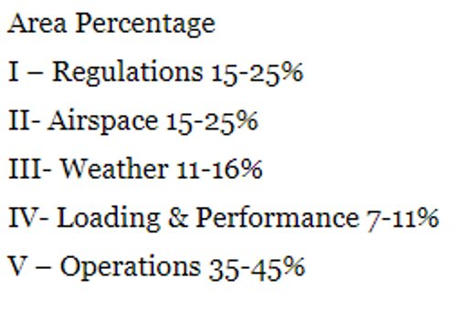
Federal drone laws
FAA – Federal Aviation Administration ​
UAS – Unmanned Aircraft Systems​
2 categories of flyers​
Recreational​
Commercial
Tyler Shoemake

Slide 10
Flying Rules
Always fly the drone below 400 feet​
Make sure that when you are flying your drone, it is always within your sight.​
Do not fly the drone in restricted airspace.​
Do not fly the drone over groups of people​
No under the influence flying
Tyler Shoemake

Slide 11
Flying Rules
For drones below 250 grams​
FAA requires you to take the The Recreational UAS Safety Test (TRUST)
For drones above 250 grams​
FAA requires you to take the The Recreational UAS Safety Test (TRUST)
You must pay registration Fees with FAA
Tyler Shoemake

Slide 12

Vegetation Index
Examine
Examine climate trends
Estimate
Estimate water content of soils remotely
Monitor
Monitor drought
Schedule
Schedule crop irrigation, crop management
Monitor
Monitor evaporation and plant transpiration
Tyler Shoemake

Slide 13
Resources
https://en.wikipedia.org/wiki/Vegetation_Index#List_of_Vegetation_Indices​
https://en.wikipedia.org/wiki/Normalized_difference_vegetation_index#Agriculture_Applications​
https://digitalcommons.unl.edu/cgi/viewcontent.cgi?article=2161&context=usdaarsfacpub​
https://en.wikipedia.org/wiki/Normalized_difference_vegetation_index
The Recreational UAS Safety Test (TRUST)
Tyler Shoemake

Slide 14
Dustin Williams

Slide 15
AirSim Overview
Microsoft AirSim is a free and open source drone simulator for Unreal Engine (with an experimental branch available to use with the Unity game engine)
AirSim can be used as a plug-in for any Unreal Engine environment
Supports quadcopters, hexacopters, cars, or any other remote-controlled vehicles

Slide 16
AirSim Overview
AirSim uses a built-in flight controller called simple_flight by default
The flight controller can be changed to the PX4 or Ardupilot flight controllers through the configuration file
Supports either hardware-in-loop with hardware flight controllers such as the Pixhawk 2.1 or Pixracer and software-in-the-loop with simulated flight hardware run on a virtual machine or in the Windows Subsystem for Linux
The simple_flight flight controller cannot be controlled with ground control station software (i.e., does not use the MAVLink protocol), but can be controlled through AirSim’s Python or C++ API
The PX4 and Ardupilot flight controllers can be controlled with ground control station software

Slide 17
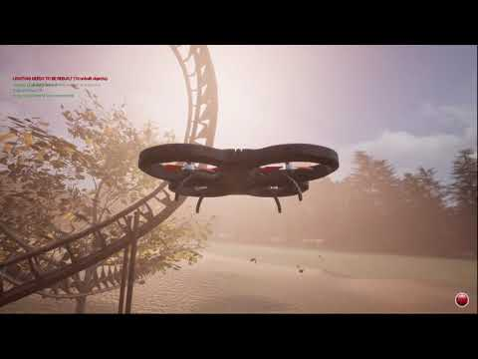

Slide 18
AirSim – Python API
AirSim includes an expansive Python API to control the drone and simulation
Common drone functionality includes the ability to arm and disarm the drone, take off and land, move to a specific coordinate in the simulated environment, move in a straight line, move along a path, rotate to a specific rotation, and capture images
The API also can also control aspects of the simulation, including pausing/unpausing the simulation, resetting the drone to its initial position, record flight data, as well as setting weather conditions and the time of day.

Slide 19
AirSim – Agricultural Environment Implementation
I created an agricultural environment in Unreal Engine and added the AirSim plugin to it
I was able to control the drone and run autonomous missions with the PX4 flight controller and QGroundControl
With the Python API, I was able to create a script that flies the drone in a grid pattern capturing images at each grid point

Slide 20
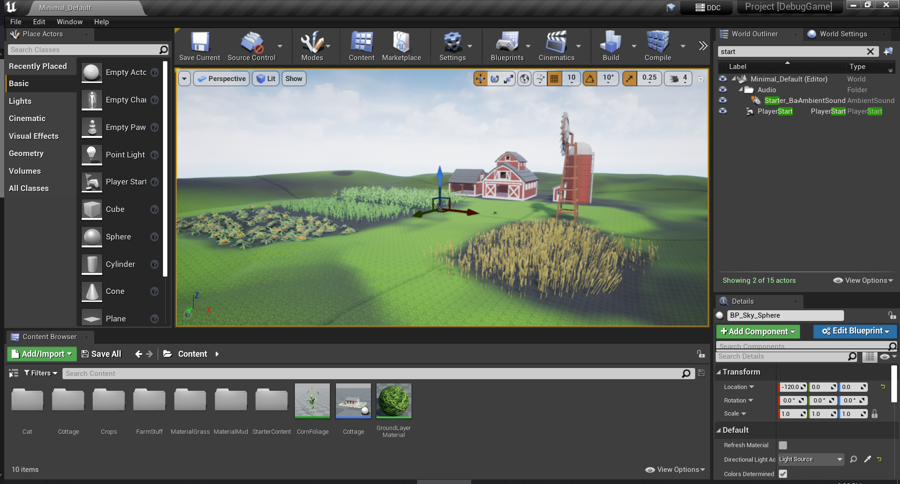

Slide 21
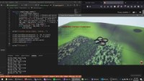
Flying the drone via Python script

Slide 22
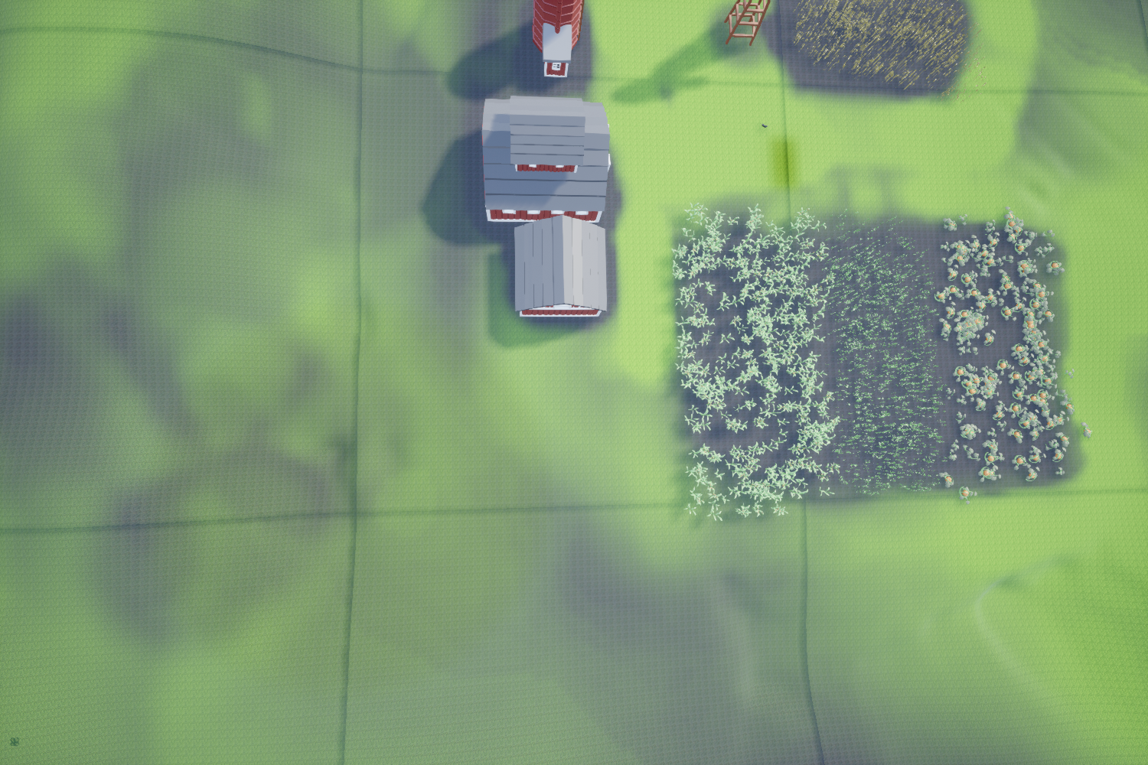

Slide 23
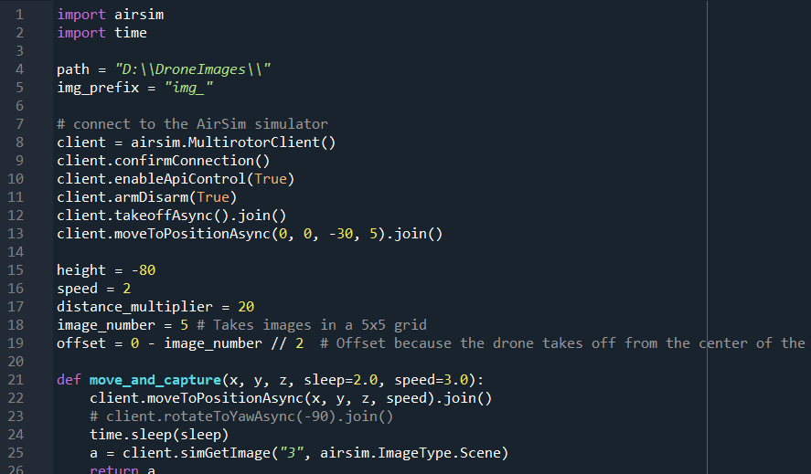

Slide 24
AirSim - Limitations
When using an external flight controller, AirSim drones only respond to actuator input for the actuators, not any other functionality (such as camera activation, camera gimble control, or other non-flight functionality supported by MAVLink)
This means that an external ground station cannot be used to plan and execute missions which take aerial photographs, makes it difficult to allow for simulating multi-spectral imaging hardware for vegetative indices, and makes it difficult for simulating other drone-based agricultural hardware (e.g., pesticide sprayers or seed spreaders)
AirSim includes a C++ MAVLink API for intercepting and interpreting MAVLink commands, so it is possible that this extra functionality could be implemented in the future

Slide 25
Citations
https://microsoft.github.io/AirSim/
https://github.com/Microsoft/AirSim/issues/734

Slide 26

Unity
Peyton Whitten

Slide 27

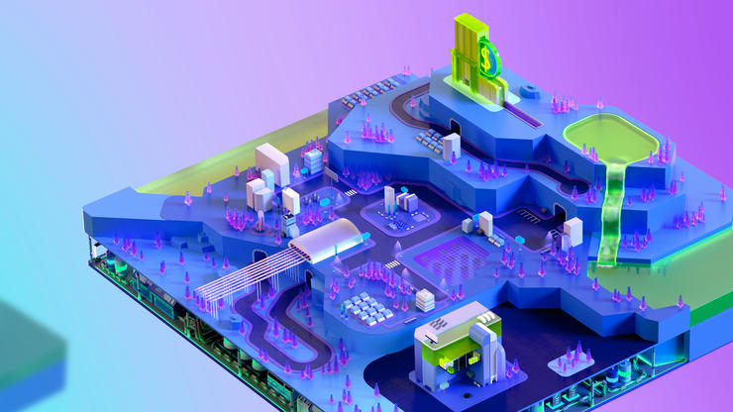

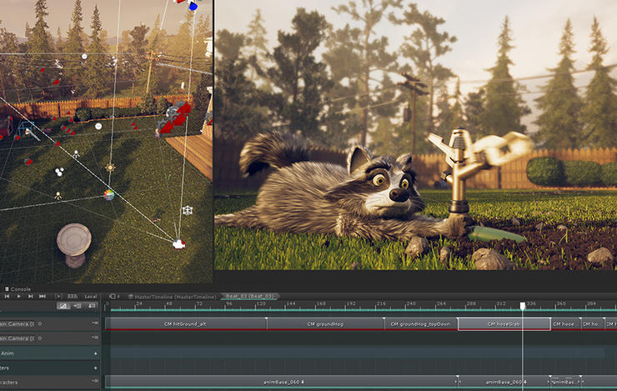
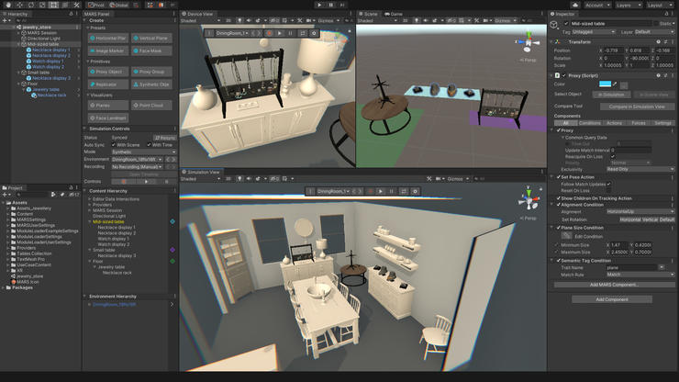
2D/3D Real-Time Development Platform
Used in:
Game Development
Automotive, Transportation, & Manufacturing
Film, Animation & Cinematics
Architecture & Engineering & Construction
Peyton Whitten
Unity.com

Slide 28
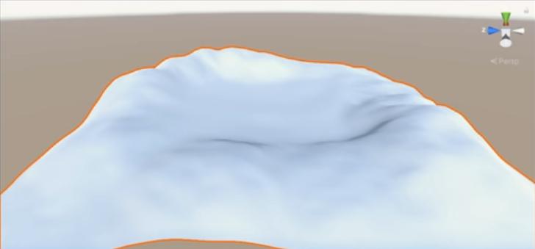
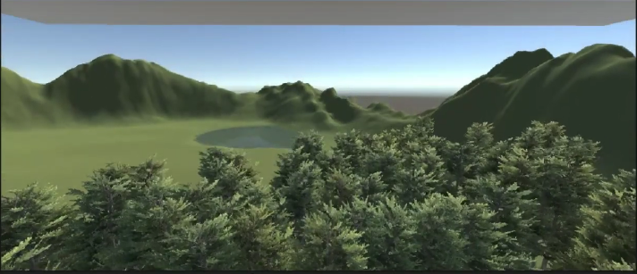
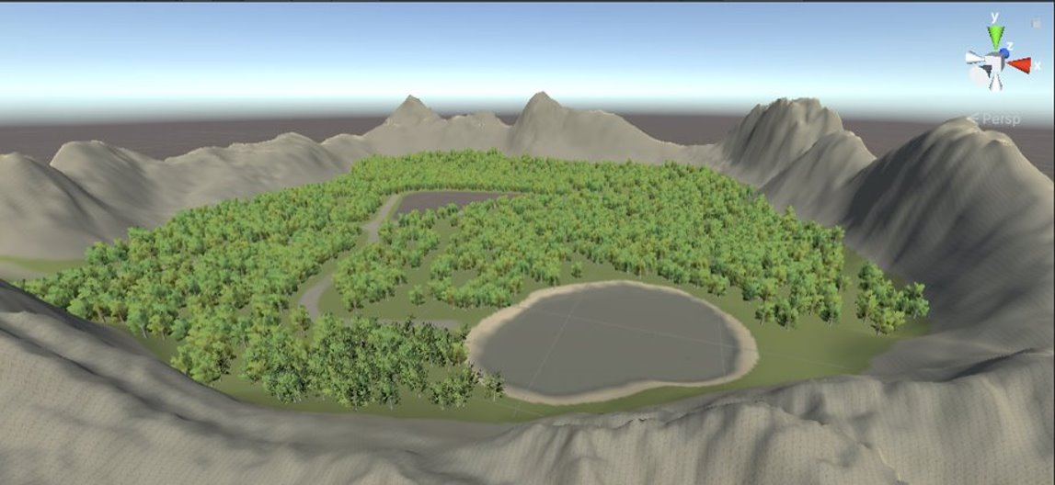
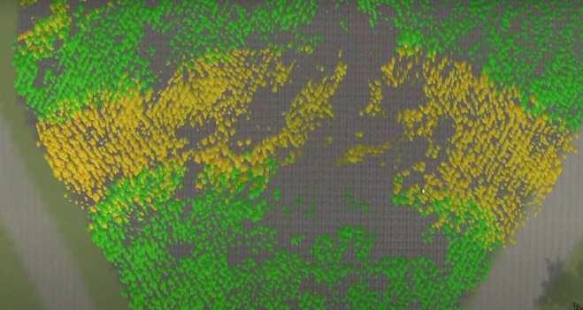
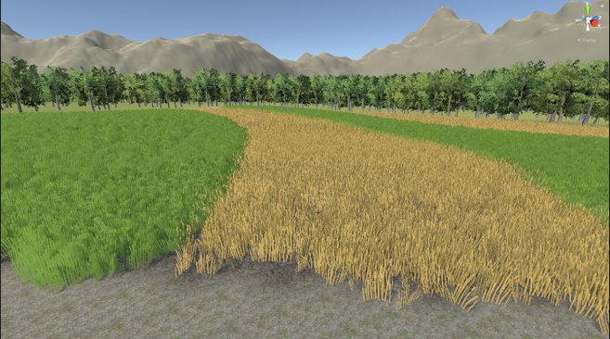
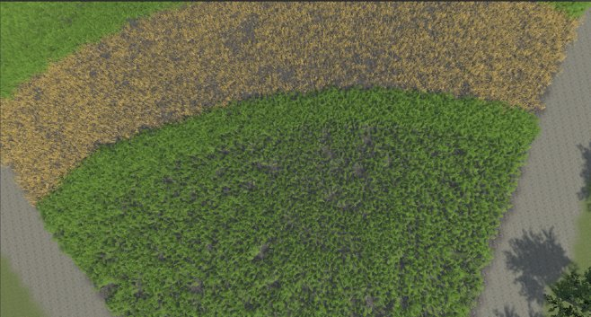
Terrain
Before
After
Peyton Whitten

Slide 29
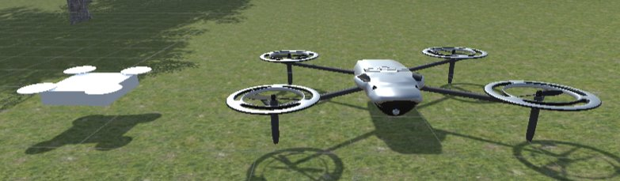
Drone
Model
Started with simple quadcopter using 5 shapes
Finally using free model from Unity's Asset Store
Scripts (GitHub)
DroneMovement.cs
Disable_Enable.cs
cameraSwitch.cs
captureImage.cs
Peyton Whitten

Slide 30
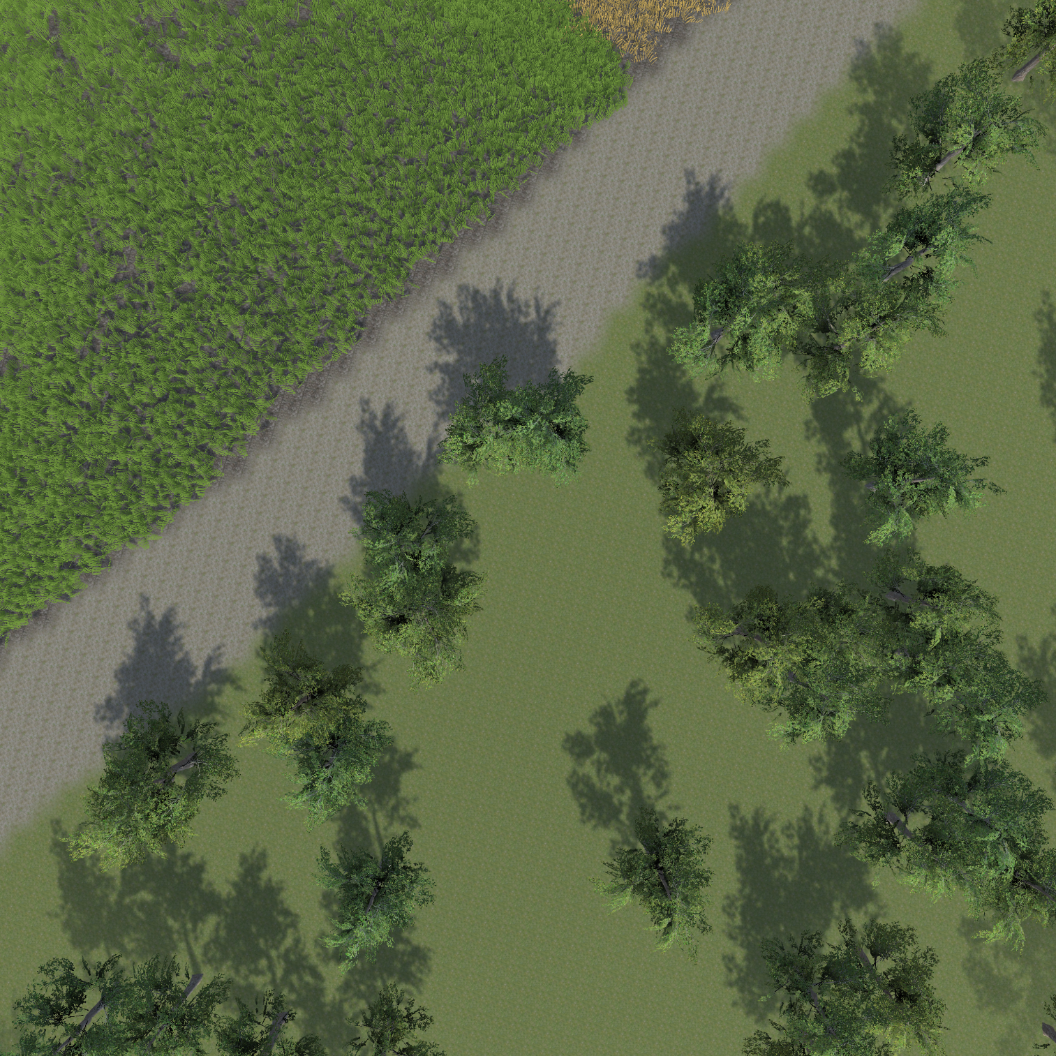
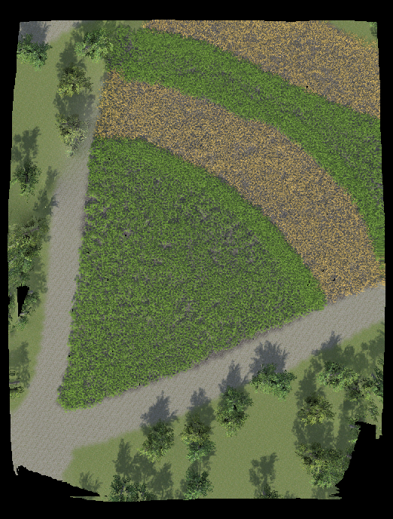
Orthomosiac Photo Using WebODM
Example of One Image
WebODM Orthophoto
Peyton Whitten

Slide 31

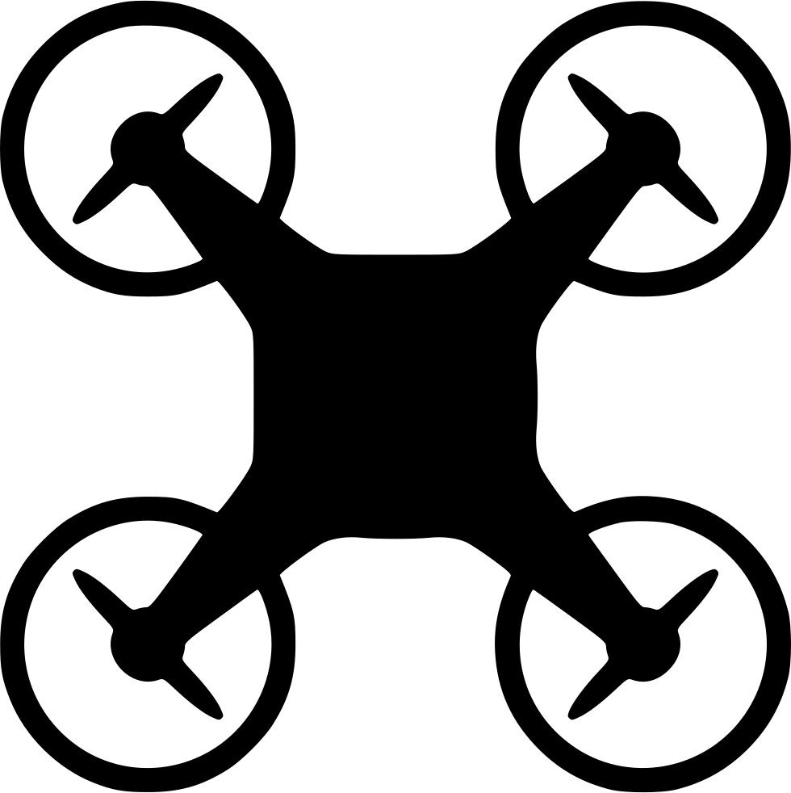

ROS + Gazebo Quadcopter Simulator
Krishnakanth Yachareni W10098930

Slide 32
What is ROS?
ROS is an open-source robot operating system
A set of software libraries and tools that help you build robot applications that work across a wide variety of robotic platforms
ROS topics are named communication buses that exchange messages between ros nodes and have anonymous publish/subscribe semantics
Several robotics sensors that are supported by official ROS packages
algorithms
sensors
topics
controllers

Slide 33
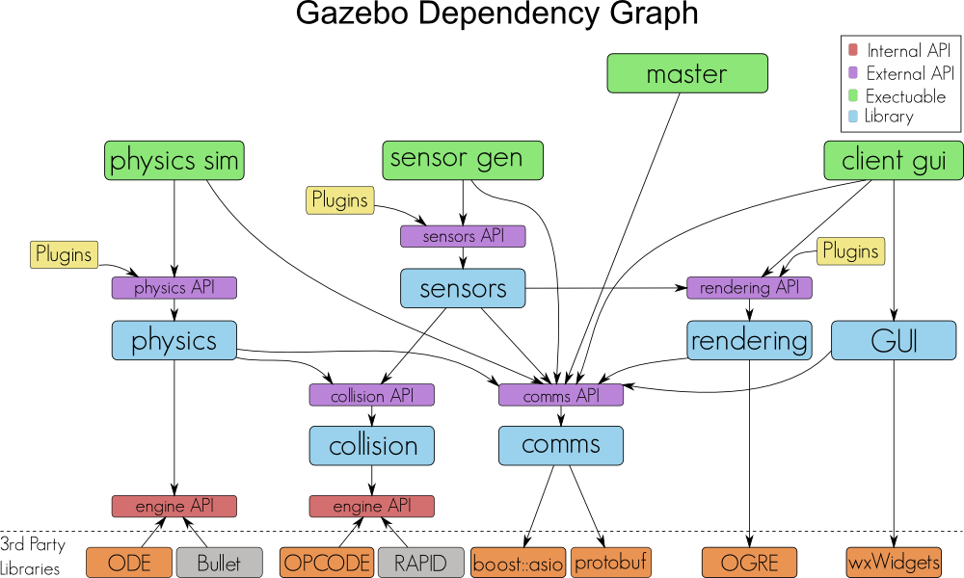
What is Gazebo?
A simulator for robot research
Real time physic engine
High-quality graphics (ORGE)
A rich set of Sensor & Plugins

Slide 34

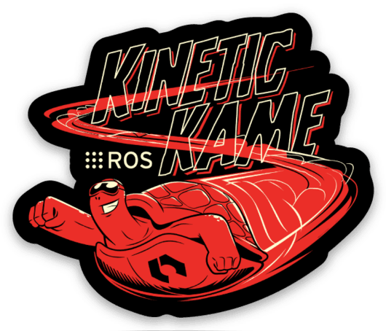
Implementation: Environment Requirements
Linux: Ubuntu 16.04.6 LTS (Codename: xenial)
ROS-kinetic distribution
Gazebo version 11

Slide 35
Implementation: Simulated Drone Framework
lib_plugin_ros_init.so
/drone/cmd_val
/drone/land /drone/posctrl /drone/reset /drone/takeoff
Gazebo
lib_plugin_drone.so
/drone/imu
lib_plugin_ros_imu.so
lib_plugin_ros_cam.so
/image_raw
Gazebo Environment
ROS-Gazebo Integration
ROS Environment

Slide 36
Contd...!
lib_plugin_ros_init.so
A system plugin for gazebo server
lib_plugin_ros_drone.so
Receives commands from 'drone_keyboard’ through ROS topics
A simple pid controller for inner-loop
A simple position controller
lib_plugin_ros_imu.so
It’s sensor plugin, Publishes the imu(Inertial Measurement Unit) data to ROS.
lib_plugin_ros_cam.so
It’s sensor plugin, Publish the image data to ROS topics

Slide 37
Implementation: Drone Controller Keyboard
W
I
A
S
D
H
J
K
L
Z
X
W/S : move forward / backward
A /D : move left / right
I /K : go up /down
J /L : turn left / right
Z : take off
X : land
H : hover

Slide 38
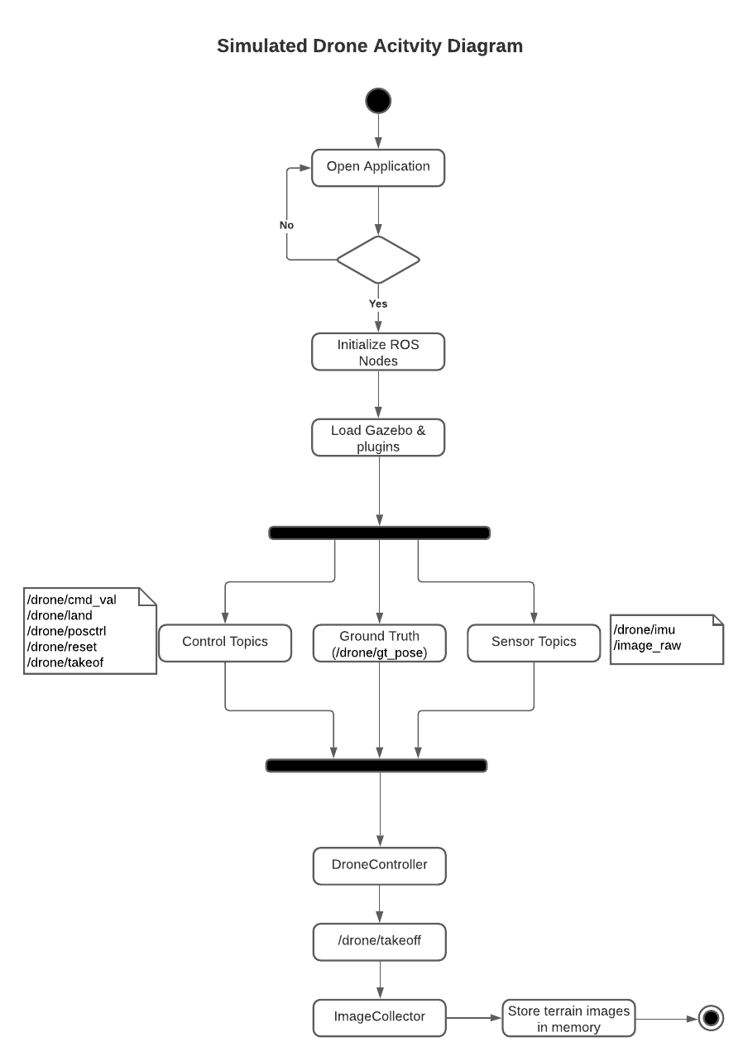
Simulated Drone Activity Diagram

Slide 39
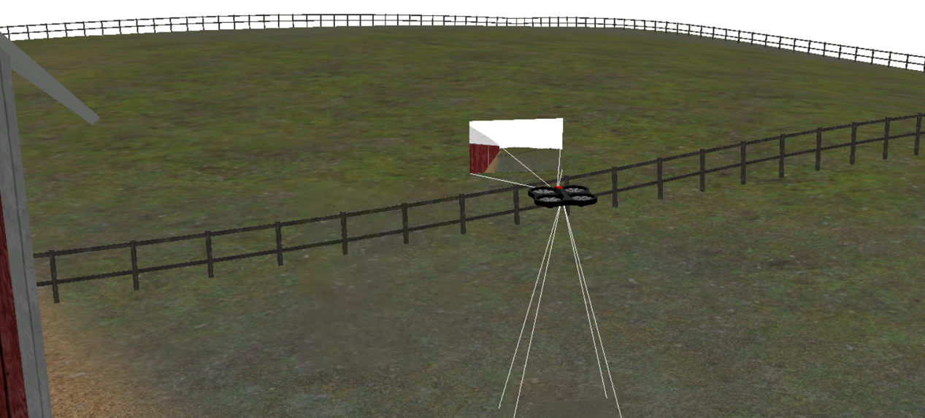
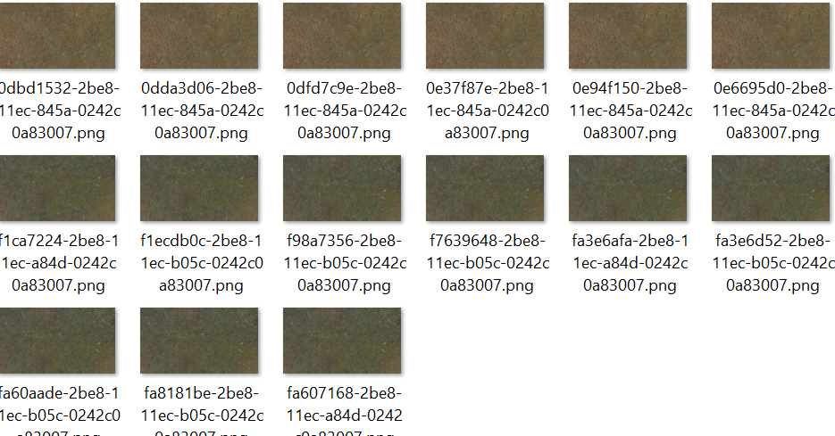
Result: Flying Drone in Agriculture Terrian
Simulated drone flying in Agriculture terrain
Drone down camera captured Agriculture terrain images

Slide 40
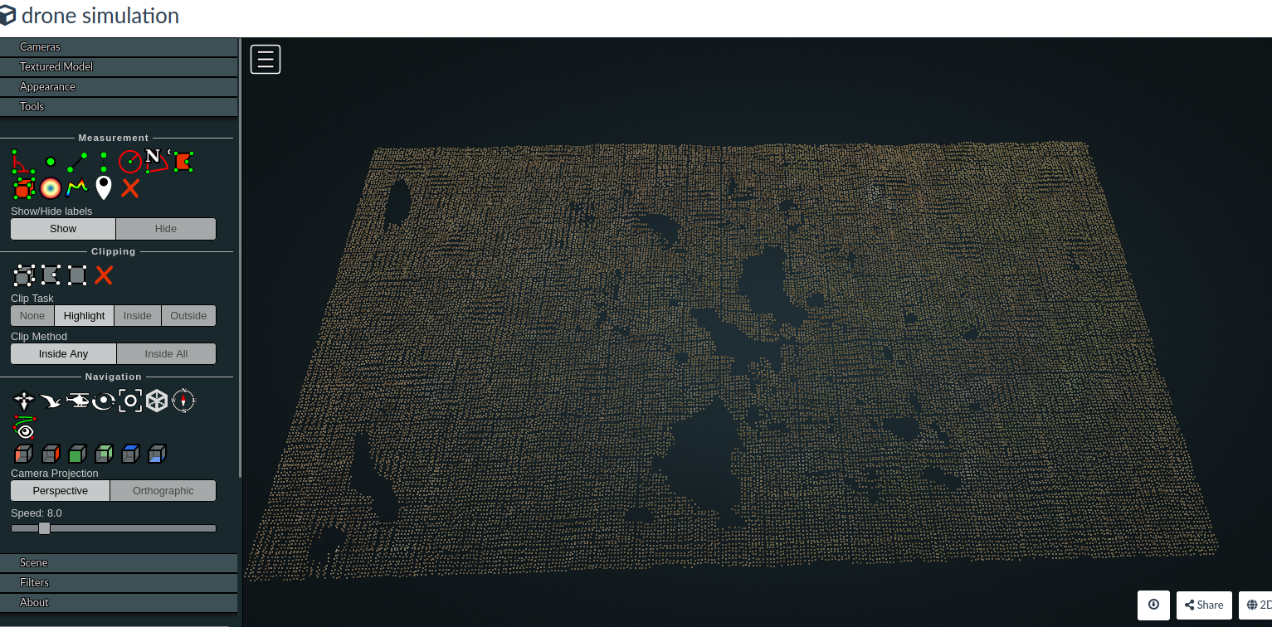
Result: Terrain Orthomosaic Map
The collected terrain Images parsed with ODM software to generate terrain Point cloud, 2D, 3D Orthophotos, Reporting.
Web ODM is the processing engine, which can be used from the command line. It takes images as input and produces a variety of outputs, including point clouds, 3D models, and orthophotos

Slide 41
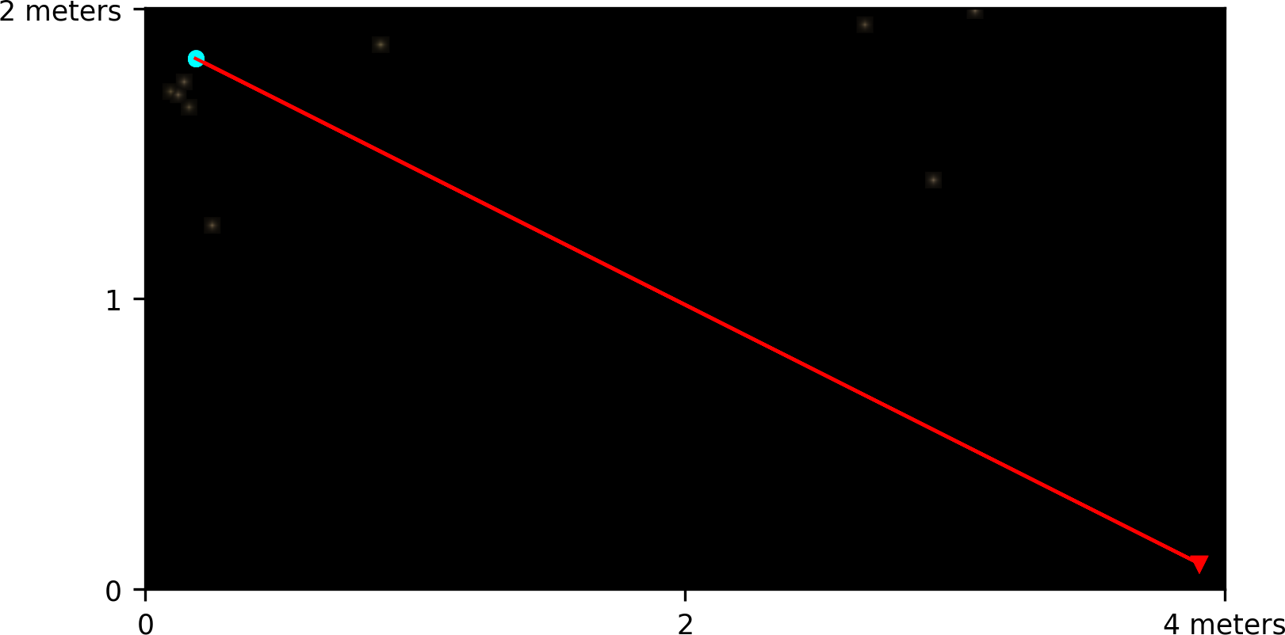
Result: ODM Quality Report of Terrain Orthomosaic
Dataset Summary
Date
Area Covered Processing Time Capture Start Capture End
02/11/2021 at 03:58:27
0.000009 km²
50.0s
01/01/1970 at 00:00:00
01/01/1970 at 00:00:00
Processing Summary
Reconstructed Images
Reconstructed Points (Sparse) Reconstructed Points (Dense) Detected Features Reconstructed Features Geographic Reference
GPS errors
7 over 23 shots (30.4%)
270 over 2730 points (9.9%)
42,424 points
650 features
178 features
GPS
9.99 meters

Slide 42
Sentinel-2 : Satellite for Crop Specific Monitoring
•Sentinel Hub is an engine for processing petabytes of satellite data. This data is helping hundreds of application developers worldwide to solve many real worlds issues like better farming, reducing water in irrigation.
•The Sentinel-2 mission consists of two satellites developed to support vegetation, land cover, and environmental monitoring.
•Sentinel-2A, 2B are an Earth observation mission from the lowest orbit of an earth, which acquires optical imagery at high spatial resolution (10 m to 60 m) over land and coastal waters.
Durga Sai Kiran Anagani W10101459

Slide 43
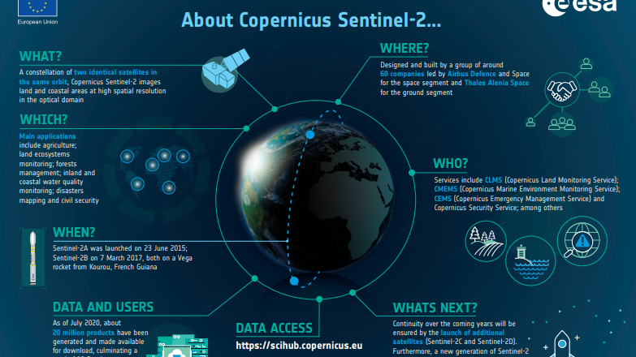
Sentinel-2 : Satellite for Crop Specific Monitoring

Slide 44
Sentinel-2 : Satellite for Crop Specific Monitoring
•The Copernicus Program, led by the ESA, is a program aimed to increase the satellite-based Earth observation capacities and within which Sentinel-2 twin platforms were launched.
•Sentinel-2A, 2B are in orbit and collecting data.
•The data collected from the Sentinel are more readily accessible and more openly free for a more globally coordinated remote sensing of agriculture in this case.
•They calculate the radiation that reflects up from the ground by using Landsat satellites images and every 8 days new images will be supplied.

Slide 45
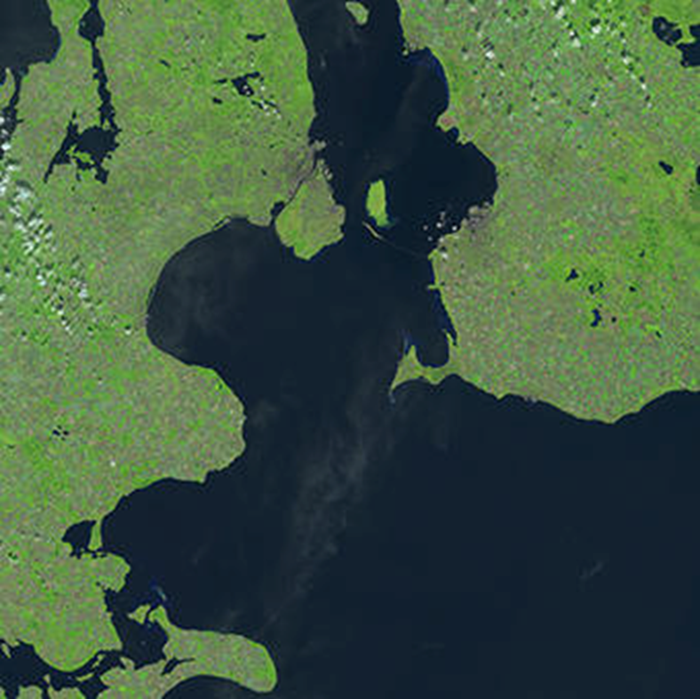
Sentinel-2A tile over a portion of Denmark and Sweden

Slide 46
Sentinel-2 : Satellite for Crop Specific Monitoring
•The launches of Sentinel-2 A, B twin platforms by the European Space Agency (ESA) has resulted in an improvement of precision agriculture possibilities.
•Together they cover all Earth’s land surfaces, large islands, and inland and coastal waters every five days.
•Plants interact with sunlight.
•The electromagnetic radiation that is reflected by plants contains information about their biophysical composition and physiological status and can be measured using satellite sensors.
•Due to Sentinel-2 red-edge bands characteristics, the biophysical parameters estimation have higher accuracy than other satellites.

Slide 47
Agricultural Terrain
To save time I imported standard assets from the library to build terrain
Using standard assets saves time and is less hard on the machine
The assets are 2D models and do not slow down the process as much
The further you move from models the less detail they have
Importing Standard Assets

Slide 48
Agricultural Use of Drone
Population increase
Farm Waste
Reducing farm waste using drones

Slide 49
Agricultural Use of Drones
Fertilizer
Sensing leaf chlorophyl content
Less Costly
Spectral Indices

Slide 50
Satellite for Crop Specific Monitoring
Monitors wavelengths
Began in the 1960's
The longest continuous space-based record of earth
Easily observe large areas of land
Infared radiation
Landsat is still up to date today
Landsat

Slide 51
GCS Software
Mobile
Tower
MAV Pilot
SidePilot
AndroPilot
Desktop
Mission Planner
AMP Planner 2
MAVProxy
QGroundControl
Telementary

Slide 52
Vegetative Indices Wanya

Slide 53
Vegetative Index (VI)
The Vegetative index has been around since 1974!
These are combination of spectral bands. They help identify the health of the plant. Health like radiation absorption, how much chlorophyll the plant has and green biomass
There are triband multispectral sensors, these sensors include NDVI, GNDVI, and SAVI captured via Multispectral camera remote sensing drones.

Slide 54
NDVI index
The NDVI or in other words the normalized difference vegetation index. Is one of the common indices we use. You compute NDVI index by dividing the difference and the sum of the NIR and RED.
What the Normal Difference Vegetation Index is , is a graphical indicator. We typically use this to analyze RS measurements. In this we use to see the health of the vegetation. We also have the ability within NDVI to show the growth of vegetation as well.

Slide 55
Enhanced Normalized difference vegetation index (ENDVI)
In this index, instead of the traditional red visible light. The ENDVI uses blue and green visible light. ENDVI is superior in terms of monitoring plant health. It is way more reliable in terms of keeping track of the health of the plants/crops.

Slide 56
Farmers
The NDVI is very important to people in the farming industry. This allows them to show the growth of their crops and the health. They are capable of uploading multispectral images of their crop field into a precision analytics. The feedback from these images would allow the farmer to see drought, flooded, and if the crop was not fertilized enough or over fertilized.

Slide 57
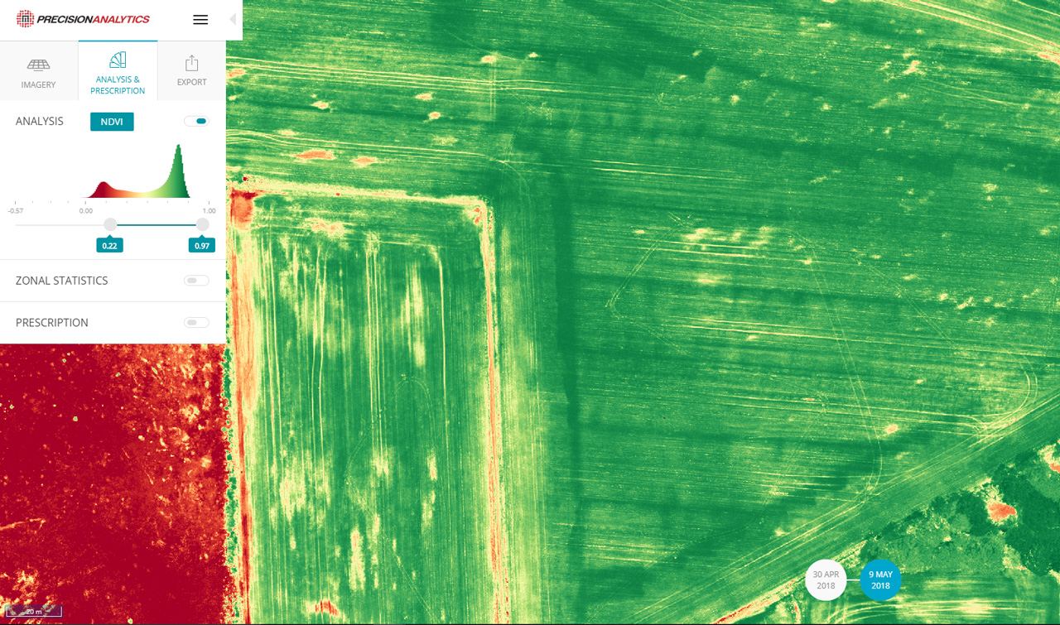
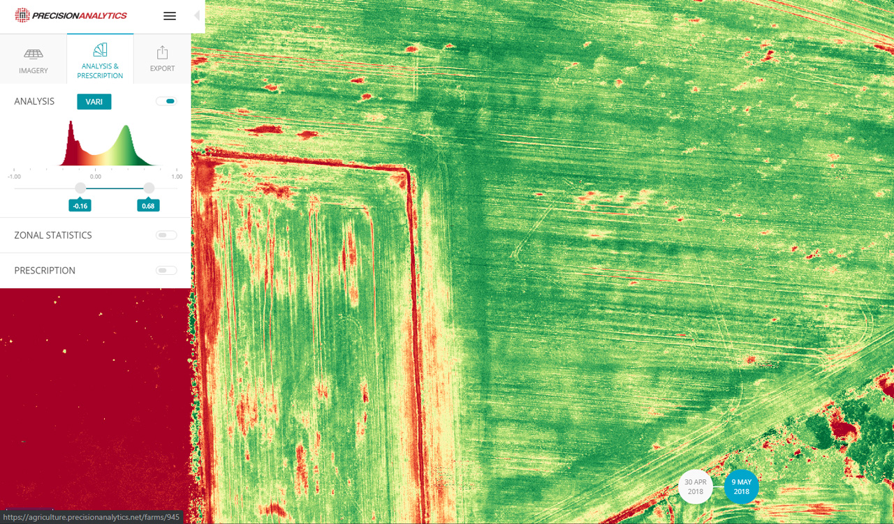
ENDVI VS NDVI

Slide 58
GNDVI
GNDVI or in other words Green Normalized Difference Vegetation Index, is used to get the numbers on photo synthesis. It is also on top of this used to show how much a plan is taking in nitrogen and water.
GNDVI = (NIR – Green) / (NIR + Green)

Slide 59
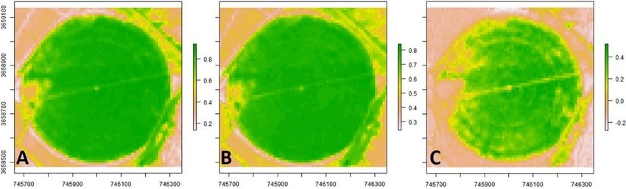
GNDVI

Slide 60
SAVI
SAVI or Soil Adjusted Vegetation Index, this index main focus is just to correct the flaws of the NDVI and enhance NDVI. It is used also to shorten the soil brightness that comes from spectral vegetation indices. This specific index is pretty useful for crops like orchards and wineries.

Slide 61
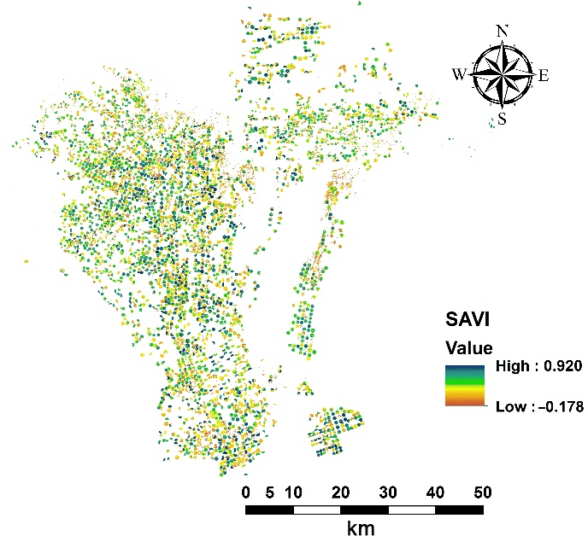
Savi Index!

Slide 62
CITATIONS
NDVI, VARI, and Other Vegetation Indices for use with Drones | PrecisionHawk
Remote Sensing | Free Full-Text | Evaluating Multispectral Images and Vegetation Indices for Precision Farming Applications from UAV Images | HTML (mdpi.com)
History of NDVI | PDF | Meteorology | Nature (scribd.com)
SAVI and NDVI spectral index comparison (geo.university)

